Slide 1
Phase Space Reconstruction

Slide 2
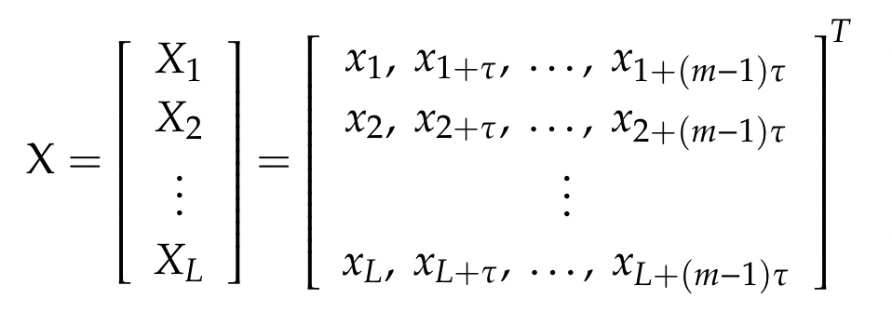
Phase Space Reconstruction
The basic concept of phase space reconstruction is to treat the value of a specific variable at a certain moment and those values after τ, 2τ,..., (m − 1)τ time intervals as coordinates of a special point in m-dimension phase space.
A graphical representation of a nonlinear system can be obtained through describing a sequence of data points in the above phase space.

Slide 3
Delay time
The delay time τ is an important parameter of the PSR method. A good choice of τ facilitates the performance analysis.
If the value is low, the adjacent successive elements xi+τ and xi+2τ of the vectors are strongly correlated; if it is high, the adjacent elements are almost independent.
Here we use mutual information function to choose a proper delay time.

Slide 4
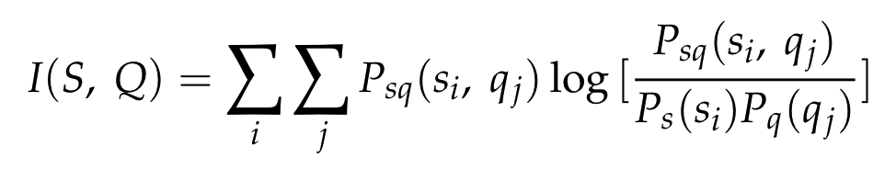
Delay time
[s, q] = [x(t), x(t + τ)]
A delay time τ is determined by dropping the I(S, Q) value to a sufficient small value 1/e.(here we not need to care about that cause we just want the image itself)

Slide 5
Dimension
Here we choose 2 as the dimension to convert the 1D data to 2D space

Slide 6
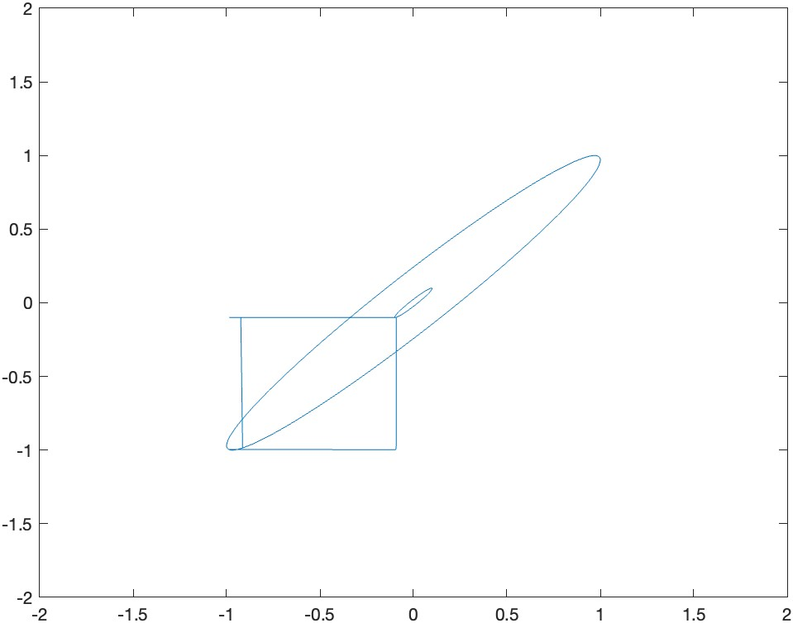
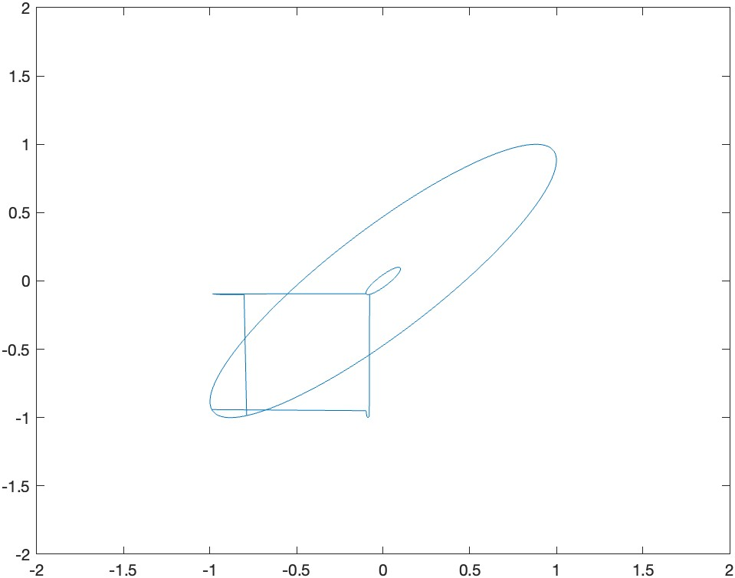
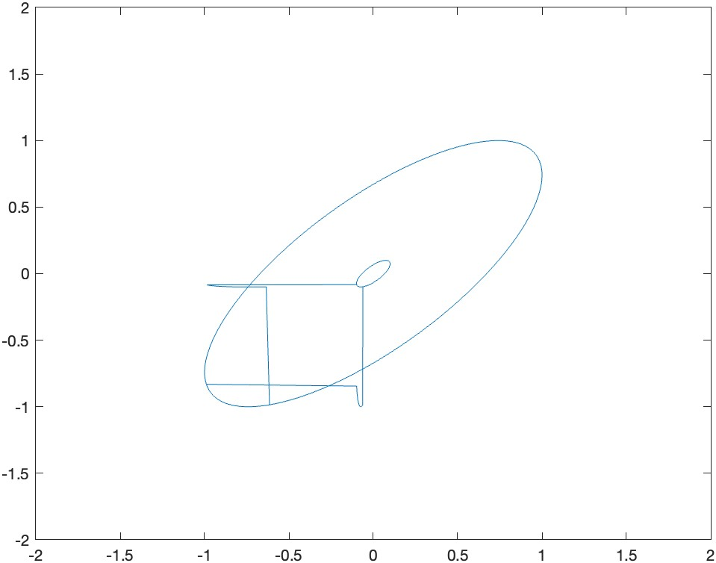
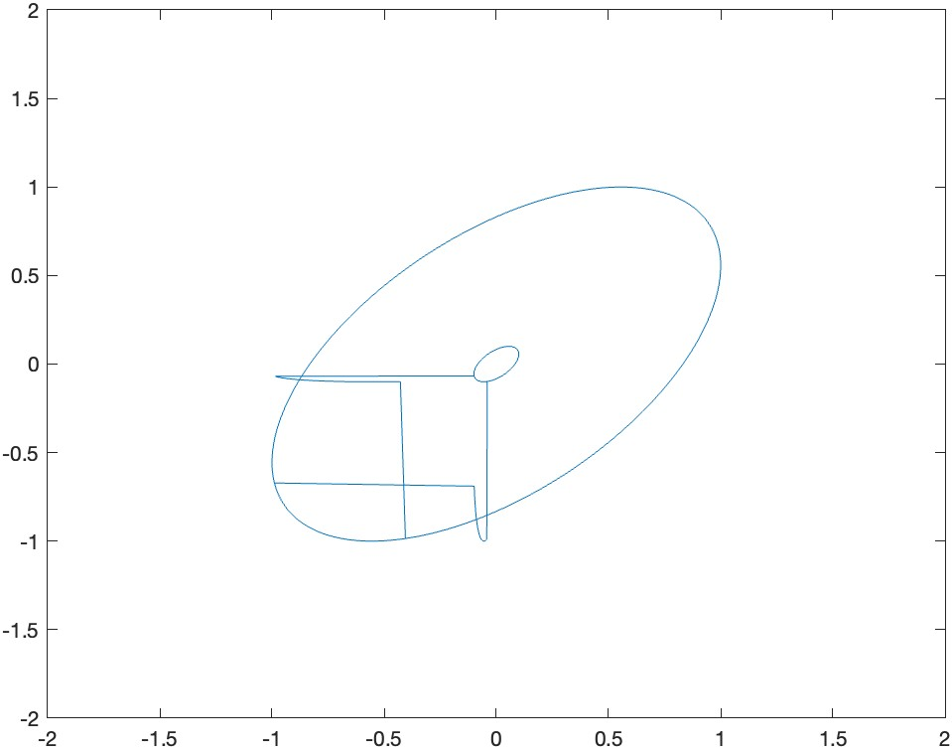
Different delay time
10
20
30
40

Slide 7
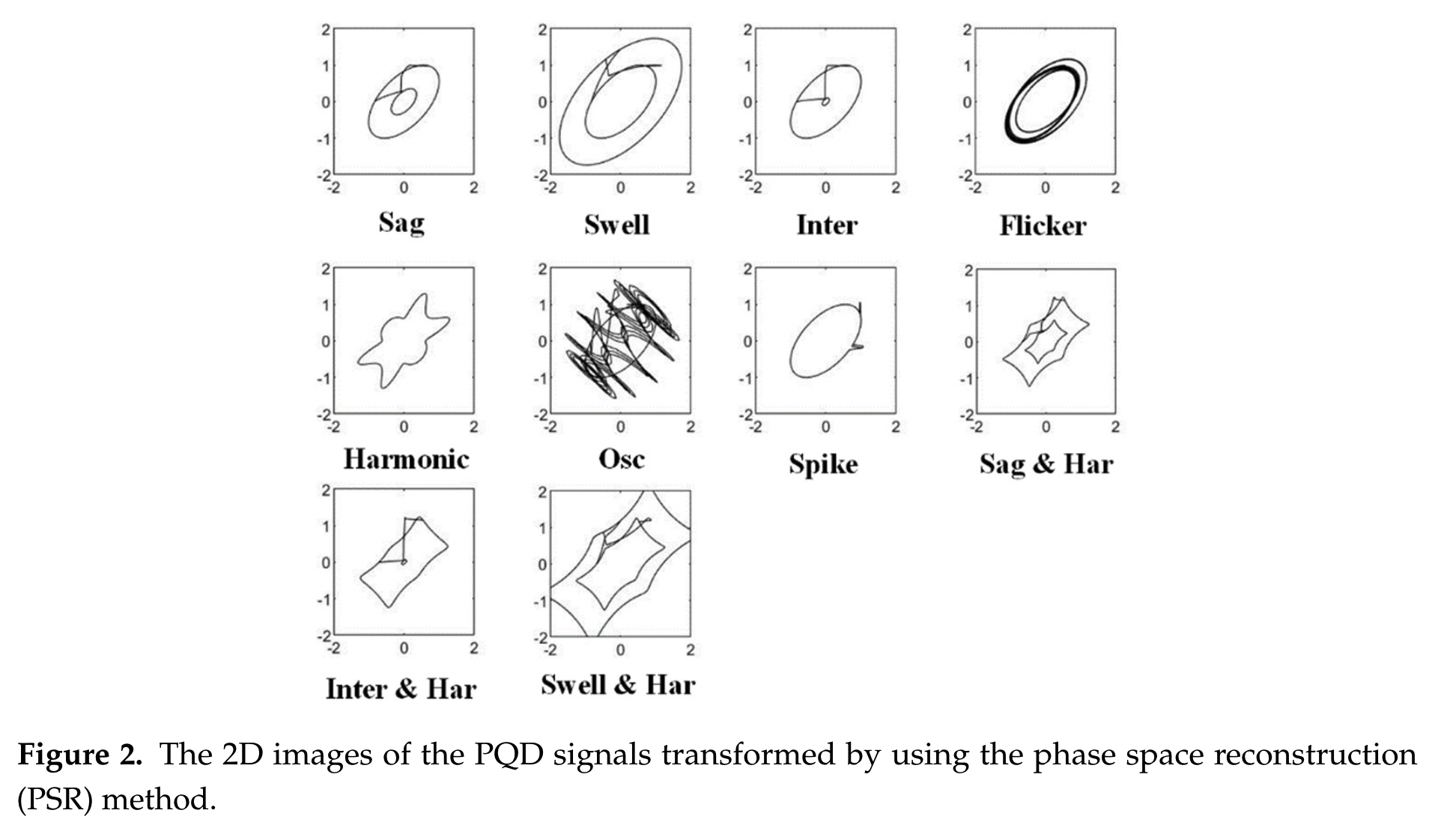
Cai, Kewei, et al. "Classifying power quality disturbances based on phase space reconstruction and a convolutional neural network." Applied Sciences 9.18 (2019): 3681.

Slide 8
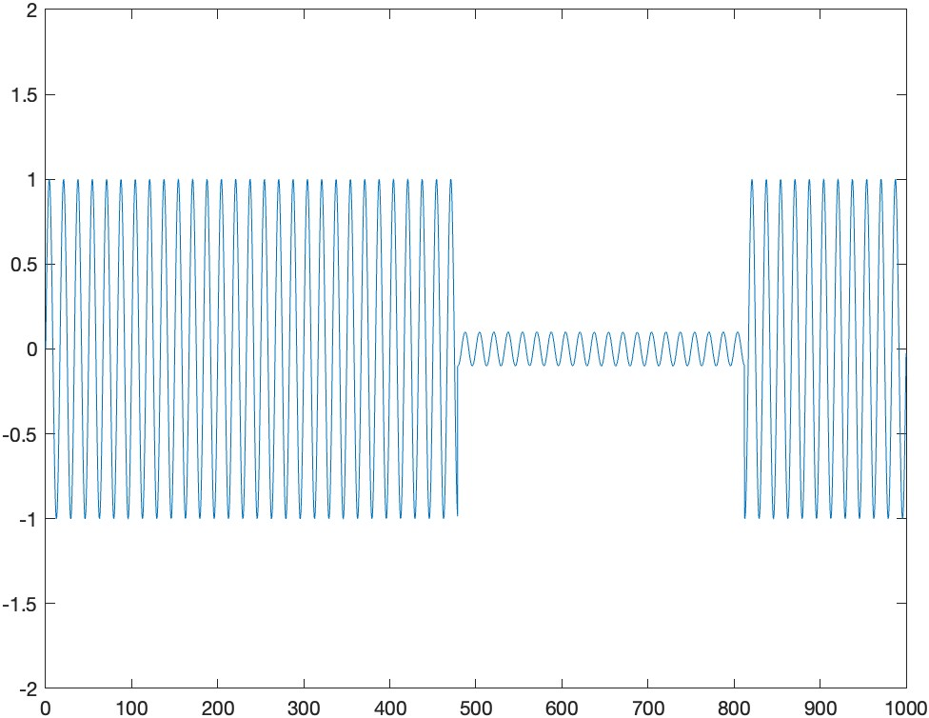
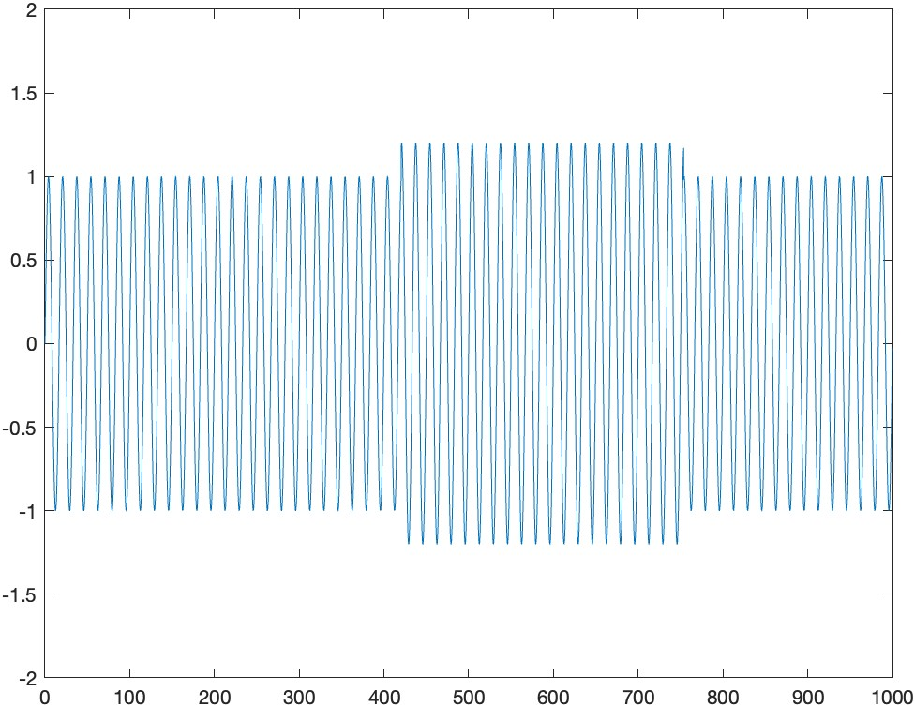
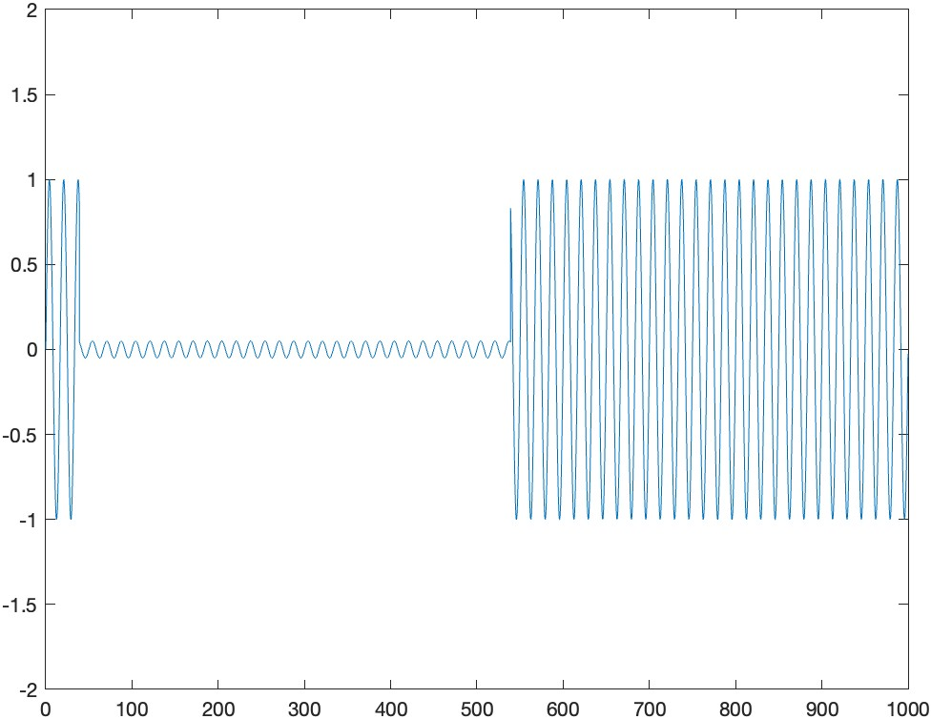
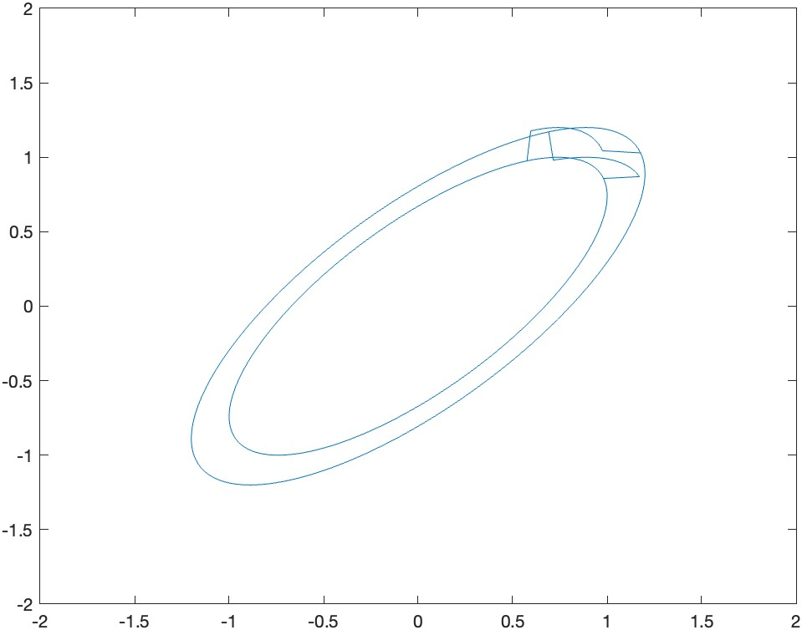
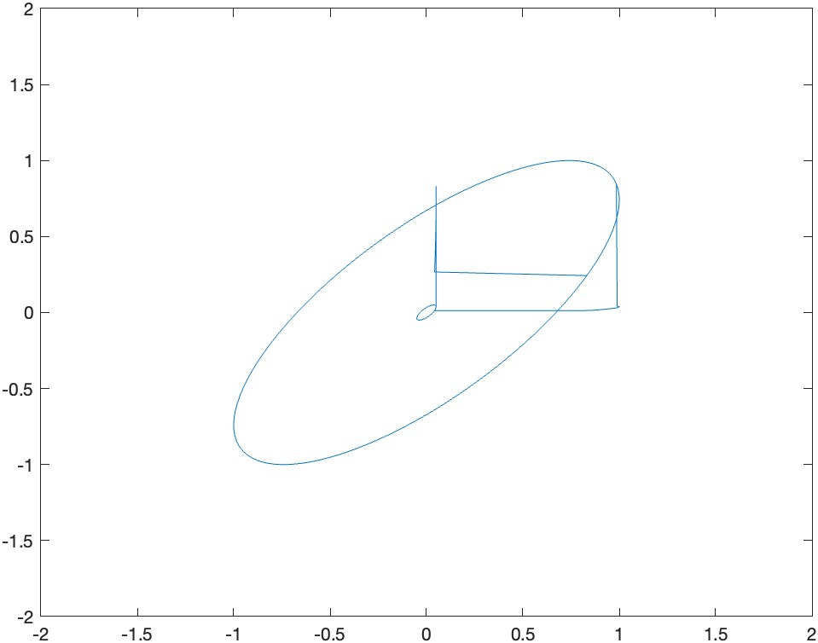
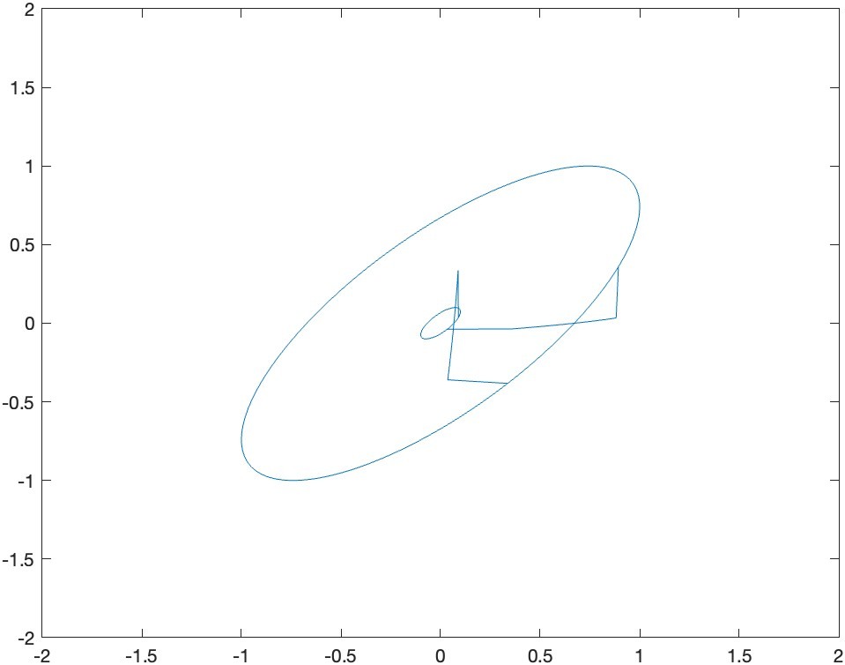
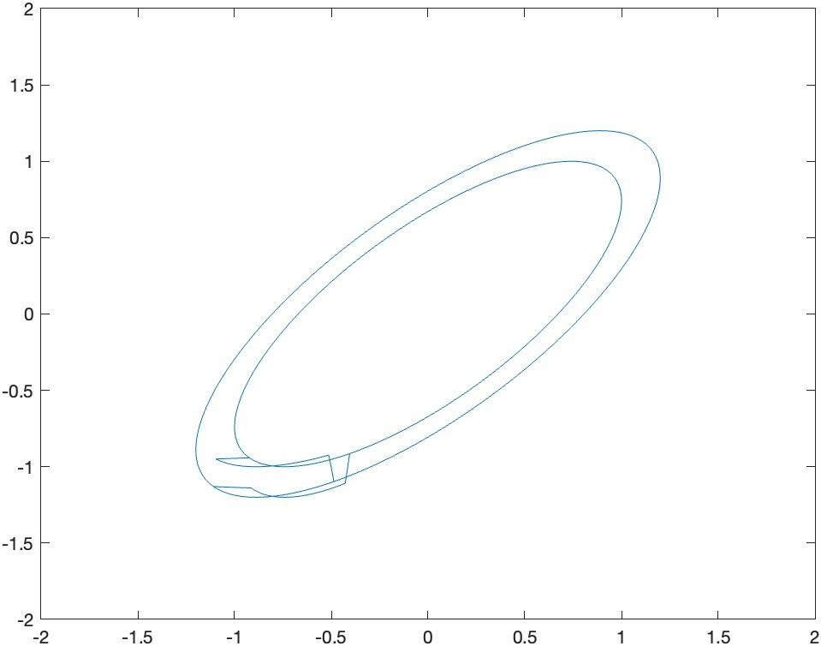
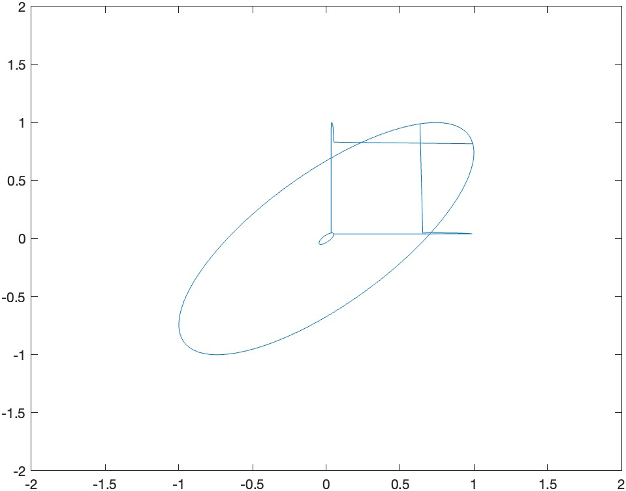
Sag
Swell
Interruption
Delay time:
30

